Slide 1
MDT – Bad/Worst Grid Identification with Multi Process and Parallelization Big Data Framework - Dask

Slide 2
There are various MPP Spatial Big Data Process Framework :
Apache Hadoop
Apache Spark
Apache Flink
SAP Hana
Python - Dask
Multiprocessing and Parallel Big Data Process Framework capable to :
Use multiple physical and logical CPU cores & Multi-Threading
Process hundreds – thousands of gigabyte/terabyte CSV, SQL, Parquet, or other big data format.
Divides and split the job into many cluster of computers
Increase performance of Data process (Faster process and More Flexible)
Scales up the data range (extends the quantity of data point and duration)
Scalable from laptop (small data process) to big server
Dask is a native python module (compatible with popular python module, such as : pandas, geo pandas, numpy, etc) and mainly used in geoscience data.

Slide 3
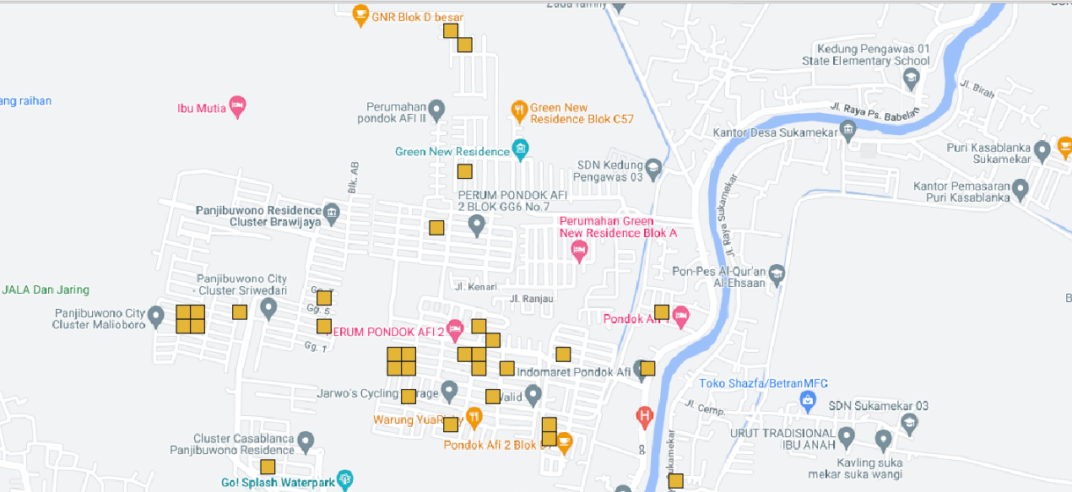
Why using MPP (Dask) for Identifying Bad Grid in the MDT
Capable to include longer duration of MDT
Example: An aggregation of entire tracked MDT RSRP/Throughput UE Report in 24 hours in 30 days in the area can show overall monthly result of sites or area performance
Few sample of MDT has drifted position because of GPS inaccuracy or faulty GPS UE, which adding more data with greater accuracy can improve the methods and result
Better performance and speed result compared to single and series process in same duration of data.
There is existing server infrastructure to support big data process. More flexible to display rsrp /throughput cell level contributor, cell id, site ID, and sample population in the grid
Native Python Classes Module, Smooth Integration with existing code

Slide 4
Defining The RSRP Worst Grid
The grid is created custom by 50x50 meter using EPSG:4326 – WGS 84
Minimal distance bad grid and related NE is 500 meters
The population of bad grid could be quantify based on how busy/many sample are available there. These could be as a parameter to approximate how many UE are there in a month or any duration.
The methods is averaging these sample and set a threshold <-105 dbm by RSRP or UE Throughput with less than 2/3/4 Mbps.
To detail it, we can identify what/whose eNB Sites or Sector contributor which give worst grid in the area
Site ID | CI | polygon_shape in WKT | rsrp-l1800-level | rsrp-l1800-grid
Site ID-A | 6 | POLYGON ((107.067561 -6.398428, 107.06792 -6.398428, 107.06792 -6.398068, 107.067561 -6.398068, 107.067561 -6.398428)) | -109.9334583 | 7469
Site ID-B | 6 | POLYGON ((107.05606 -6.378301, 107.05642 -6.378301, 107.05642 -6.377942, 107.05606 -6.377942, 107.05606 -6.378301)) | -109.781013 | 7384
Site ID-C | 5 | POLYGON ((107.406116 -6.091141, 107.406475 -6.091141, 107.406475 -6.090781, 107.406116 -6.090781, 107.406116 -6.091141)) | -106.2572718 | 5982
Site ID-A | 15 | POLYGON ((107.320938 -6.419632, 107.321297 -6.419632, 107.321297 -6.419273, 107.320938 -6.419273, 107.320938 -6.419632)) | -109.2578748 | 5270
Site ID-B | 4 | POLYGON ((107.275654 -6.21729, 107.276013 -6.21729, 107.276013 -6.216931, 107.275654 -6.216931, 107.275654 -6.21729)) | -105.1043062 | 4180
Site ID-C | 4 | POLYGON ((107.242229 -6.278388, 107.242589 -6.278388, 107.242589 -6.278029, 107.242229 -6.278029, 107.242229 -6.278388)) | -107.088989 | 3551
Site ID-A | 6 | POLYGON ((106.841498 -6.871039, 106.841858 -6.871039, 106.841858 -6.870679, 106.841498 -6.870679, 106.841498 -6.871039)) | -114.6925557 | 3412
Site ID-B | 5 | POLYGON ((107.059295 -6.326907, 107.059654 -6.326907, 107.059654 -6.326548, 107.059295 -6.326548, 107.059295 -6.326907)) | -113.1082277 | 3391
This examples duration only takes 6 hours a day with weekdays only without holidays. This sample could be an approximation on how many user (active&passive) and the average RSRP in the grid

